Slide 1
HOSPITAL BILLING
SYSTEM
Here is where our c/w project begins

Slide 2

INTRODUCTION
This is simple billing system that we developed using c language.it’s a combination of both system defined & user defined functions.mainly we have focused on channeling,testing,room reservations & medication operations.
Let’s have a look…

Slide 3
BEFORE YOUR FIRST RUN
Instructions before use:
We have used variables to store the data basically,So the program keeps all the values temporarily untill the user exits.when we exiting,the program saves all the patient’s data into a file But not all other variables.User needs to remove the data file before relaunching.
Remember to insert the correct data according to it’s data type.
If you entered something wrong, don’t turn back you can’t backspace.Let the program flows then it will ask you a confirmation before it proceeds(Except Medicines Func.).Enter –NO- ,Then enter the details again.
Keep the “patientdata.txt” file as a backup file.You can use both Auto & Manual methods to export patient’s data
Team 11 - DSE 23.1 Batch – National Institute of Business Management - Galle

Slide 4
TABLE OF CONTENTS
01
03
02
04
Overview
Logics
Functions & Variables
Advantages & Things to improve

Slide 5
—Stephen Hawking
“However difficult
Life may seem,There is always
Something you can do
And succeed at.”

Slide 6
01
OVERVIEW

Slide 7
ABOUT THIS TITLE
You will see how is this program executes.
You may consider this is not good designing & not the best user friendly interface but you will get better results for sure.
There are 10 options that we can go for & each one will do a specific task.

Slide 8
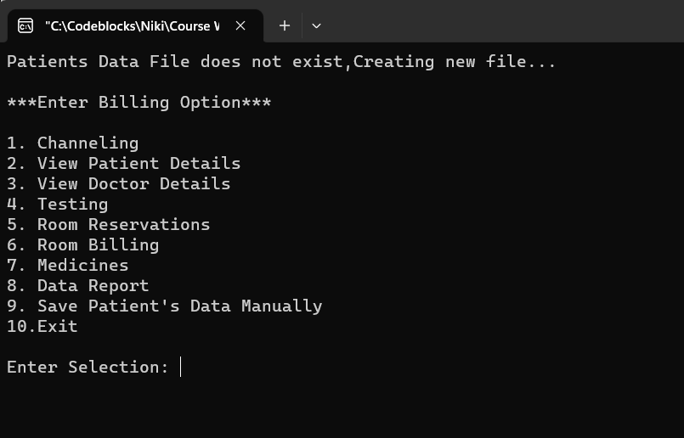
INTERFACE
This is the main user interface.Not at all for billing purpose,there are some other useful options can be choosen.
Main billing options are 1,4,6 & 7. All those functions require patient’s details at first.
User can take a report of some sort of data using function no.2,3 & 8.
If user have a file of patient’s data when recorded anytime,Function no.2 can read & output every details in that file
Selections should be between 1-10.If not,program will output a error message.

Slide 9
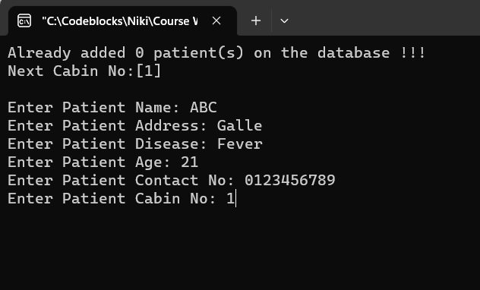
CUSTOMER REQUIREMENTS
//Assume the patient as the customer.
These details are the main requirements of the customer.
But in different functions ask different details according to it’s requirement.
As a example, Medical function asks about the medicine details

Slide 10

DATA SAVING & RETRIEVING CONCEPT
EXPORTING
BACKUP
While user exit the program or when user use manual saving option
Patient data stored in a file, can keep & use as a backup file

Slide 11

NON-PROFITABLE PROGRAMS
This system automatically reserve a fund for little hearts with 3% from room charges & 2% from medicine charges.
User can view the fund status by getting a data report.

Slide 12
02
FUNCTIONS & VARIABLES

Slide 13
TYPES OF VARIABLES
Struct Variables
Function Variables
Common Variables

Slide 14
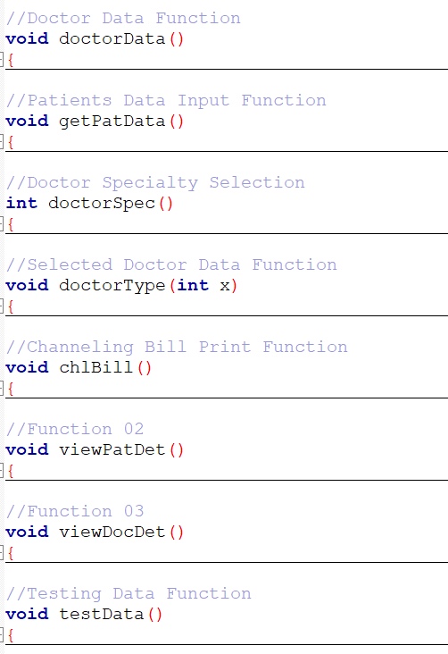
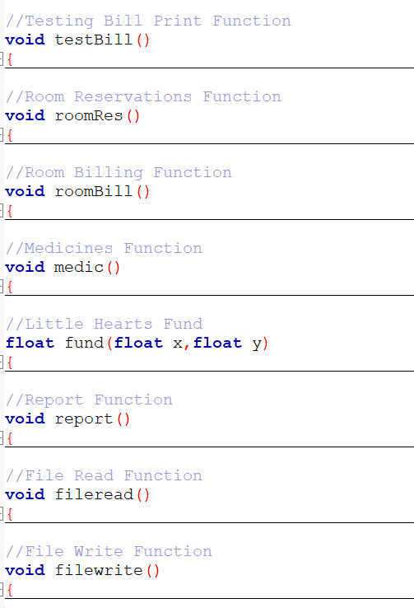

FUNCTIONS
There are 17 total functions except the main function. Some of them are designed to fill up struct data.Those functions do nothing but they are filling important data into the variables before use for the calculations.Other functions used for calculations & print outputs.

Slide 15

Solution
Problem
Struct (*struct_tag)
{ (*members_of_struct)
}[] (*size_of_struct);
How do you keep several types of data in a form of several amounts of people ?

Slide 16
03
LOGICS

Slide 17

ABOUT THIS TITLE
Logics are the most important part of computer programming.there is nothing without logics.If someone says programming is too hard to learn,it’s probably because lack of logical thinking.Programmer’s task is to delineate how elements should be arranged, so a computer can perform specific task.

Slide 18


DIFFICULTY OF CODING
85%
40%
Abstract Thinking & Logics
Writing

Slide 19
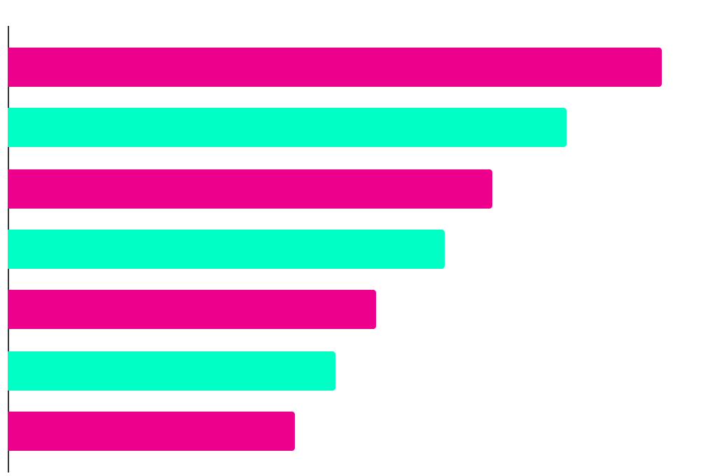
Patient Data Reading Pattern
Count
I<J; I++
I<J; I++
I<J; I++
I<J; I++
I<J; I++
I<J; I++
I<J; I++
Totpat=6/CC=5/J=CC+1/I=CC
Totpat=5/CC=4/J=CC+1/I=CC
Totpat=4/CC=4/J=CC+1/I=CC
Totpat=3/CC=3/J=CC+1/I=CC
Totpat=2/CC=2/J=CC+1/I=CC
Totpat=1/CC=1/J=CC+1/I=CC
Totpat=0/CC=0/J=CC+1/I=CC
0 1 4 100
Patients
CC=CabinCount

Slide 20
CHANELLING PROCESS
Step 1
Step 2
Step 3
Step 4
Step 5
Step 6
Read patient data
Select doctor speciality by disease
Show doctors in selected speciality
Proceed for an appointment
Chanelling patients +1
Cabin number +1
Patient type = 1
Print the bill

Slide 21
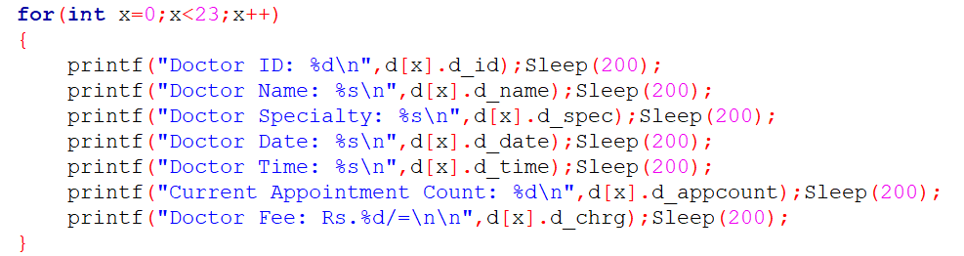
For Loop Used to Display Doctors Data
It’s not a good use to write lines for all the repetitive data. So we have used “for loop” to
run 23 times of ‘x’ value
0 to 22.
d[x] ← Represent the data of ‘d’ struct, [x] position.
.d_id, .d_name… ← Members of ‘d’ struct. It contains different types of data defined in that struct.

Slide 22
Solution
Problem
Sleep(1000);
*1000 = 1 Sec
How can you print the outputs with some delay ?

Slide 23
doctorSpec()
doctorType(int x)
doctorType(k)
Return k;
(K:Speciality Number)
Function required integer value
Show doctors data for X value
In main function we call doctorType function with value of K

Slide 24
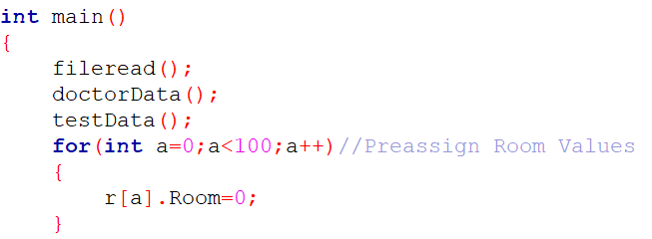
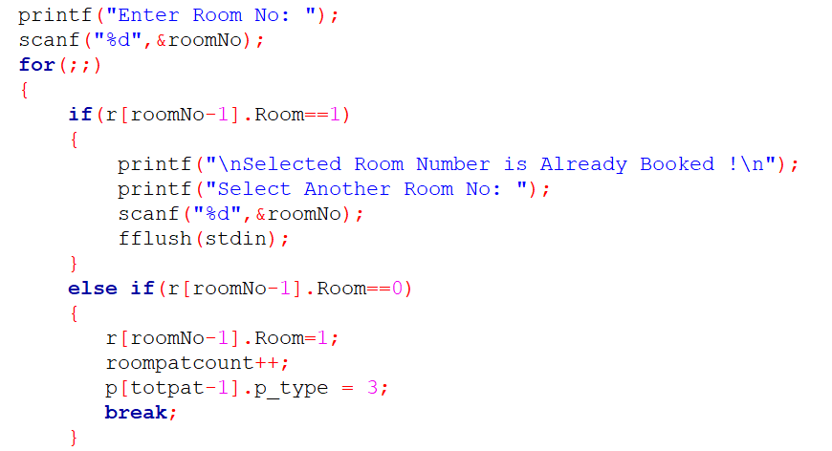
We have allocated a struct named “Rooms” of amount of 100 rooms.
Then assigned all the room values to 0 in the main fuction.
In the room reservation function, User can ask for a any room number between 1-100 but the program will check if the entered room number value is equal 0 or 1.
If it’s value equal to 1, It means selected room is already booked. So the user have to select another room number & if it’s 0,user can reserve that room then it’s value will be changed to 1.

Slide 25
ROOM ACCOMMODATIONS
 | AC | Non-AC
Rooms | 60 | 40
R.Charge | 12,000 | 8,500
Serv.Crg | 2,450.50 | 2,450.50

Slide 26
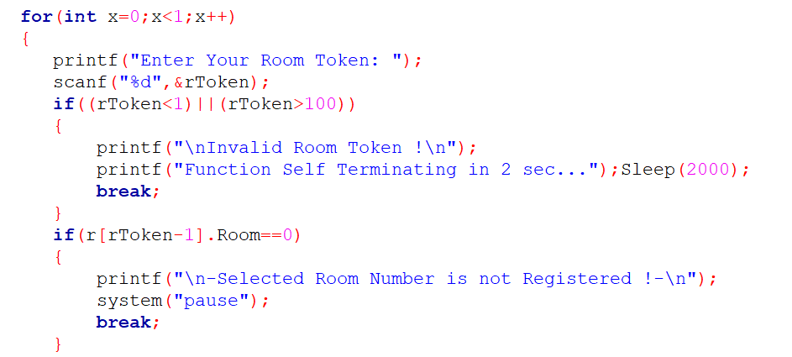
Condition Before Print the Room Bill
If user wants to take a bill for room, it must be used. So the program asks a token number that has been issued by room reservations. We are checking two criterias to filter correct room number.
1 ⬅ Token number must between 1 – 100. If not, the loop will break.
2 ⬅ Entered token number value must be 1. If not, It means it’s still unused. The loop will break.

Slide 27
Solution
Problem
System(“pause”);
Getch();
How do you pause your output until the user allows ?

Slide 28
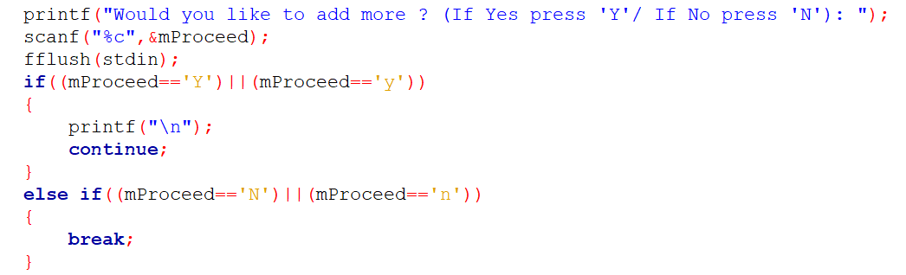
Continue & Break in Medication
If the user wants to add several medicine items, Program asks it after adding very first item. If we input –Yes-, Loop will start over.
When all the items are billed, User should input –No- to break this loop otherwise it will continue without any limitations. User can print the bill after breaking this loop.

Slide 29

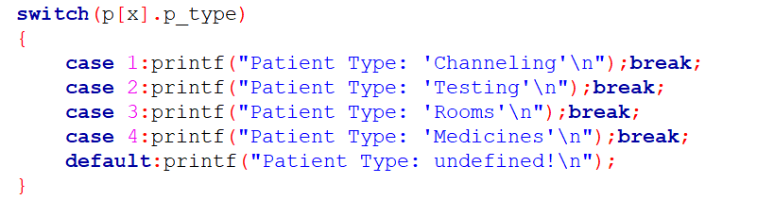

Logic Behind The Patient’s Type
Chanelling
Testing
P_type
Room Res.
Medications
Program won’t ask any input about the patient’s type

Slide 30
Solution
Problem
System(“cls”);
puts("\033[2J");
How can we move our output into a new screen ?

Slide 31
986
Lines were used to develop this program

Slide 32
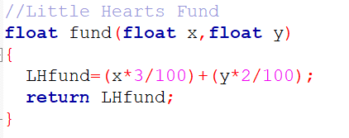
A FUND TO LITTLE HEARTS
Reserving a fund from income seems like hard but it’s actually not that much hard. We defined a float type function with the requirement of two different float values(X,Y). If we consider X & Y values separately *LHFund will assign an addition value of %3 from X & 2% from Y.
Then the function will return the value of *LHfund.
We called the function with Room Total Var. & Medicine Total Var. When we meet our printing requirement.So this function can generate a value and represent it as a variable at the same time.

Slide 33
To Get A Better Idea
Int fund(int x,int y)
{ z=(x*5/100)+(y*5/100);
return z;
}
Int main()
{ int z, int A=100, int B=200;
printf(“Value of Z = %d”,fund(A,B));
return 0;
}
OUTPUT:
Value of Z = 15

Slide 34
HOW WE HANDLE FILES
File Read
File Write
Manual Write
Import the data in the file at beginning
Export patient’s data into a file when user exiting
Export patient’s data manually using function

Slide 35

A PICTURE IS WORTH A THOUSAND WORDS

Slide 36
Solution
Problem
fflush(stdin);
How do you clear the input buffer to avoid %c read issue ?

Slide 37
04
ADVANTAGES & THINGS TO IMPROVE

Slide 38
ADVANTAGES
All Chanelling,Testing,Rooming,Medication options in 1 place.
If customer changes his mind while presenting details, there is an option to move back without saving his/her details.
If customer doesn’t request a bill, There is always an option to save all his/her data and values without printing a bill (output).
In any special occasion user can take out a report of current recorded details.
When we take out a data report, the report shows how many patients registered in different fields seperately.
Fund for “little hearts” is generating automatically.

Slide 39
ARGUMENT POINTS
Q: Do you think that we did everything right?
A: No, We’ve did many mistakes.But fortunately we’ve got rid of most faliures after a month of effort.
Q: What things do you still have left?
A:
User can’t able to manipulate data.Specially,data in the structs.
Patients data and Room data isn’t linked.
No text filtering. In some occasions user can input numbers & special characters into string types.
Which is useful in such cases like entering addresses,email…etc.
But it’s a weak point when it’s goes to enter names,diseases…etc.

Slide 40
-END-
Presented by:
Niki
Navod
Dilshan
Sasinda

Slide 41

THANKS!

